Slide 1
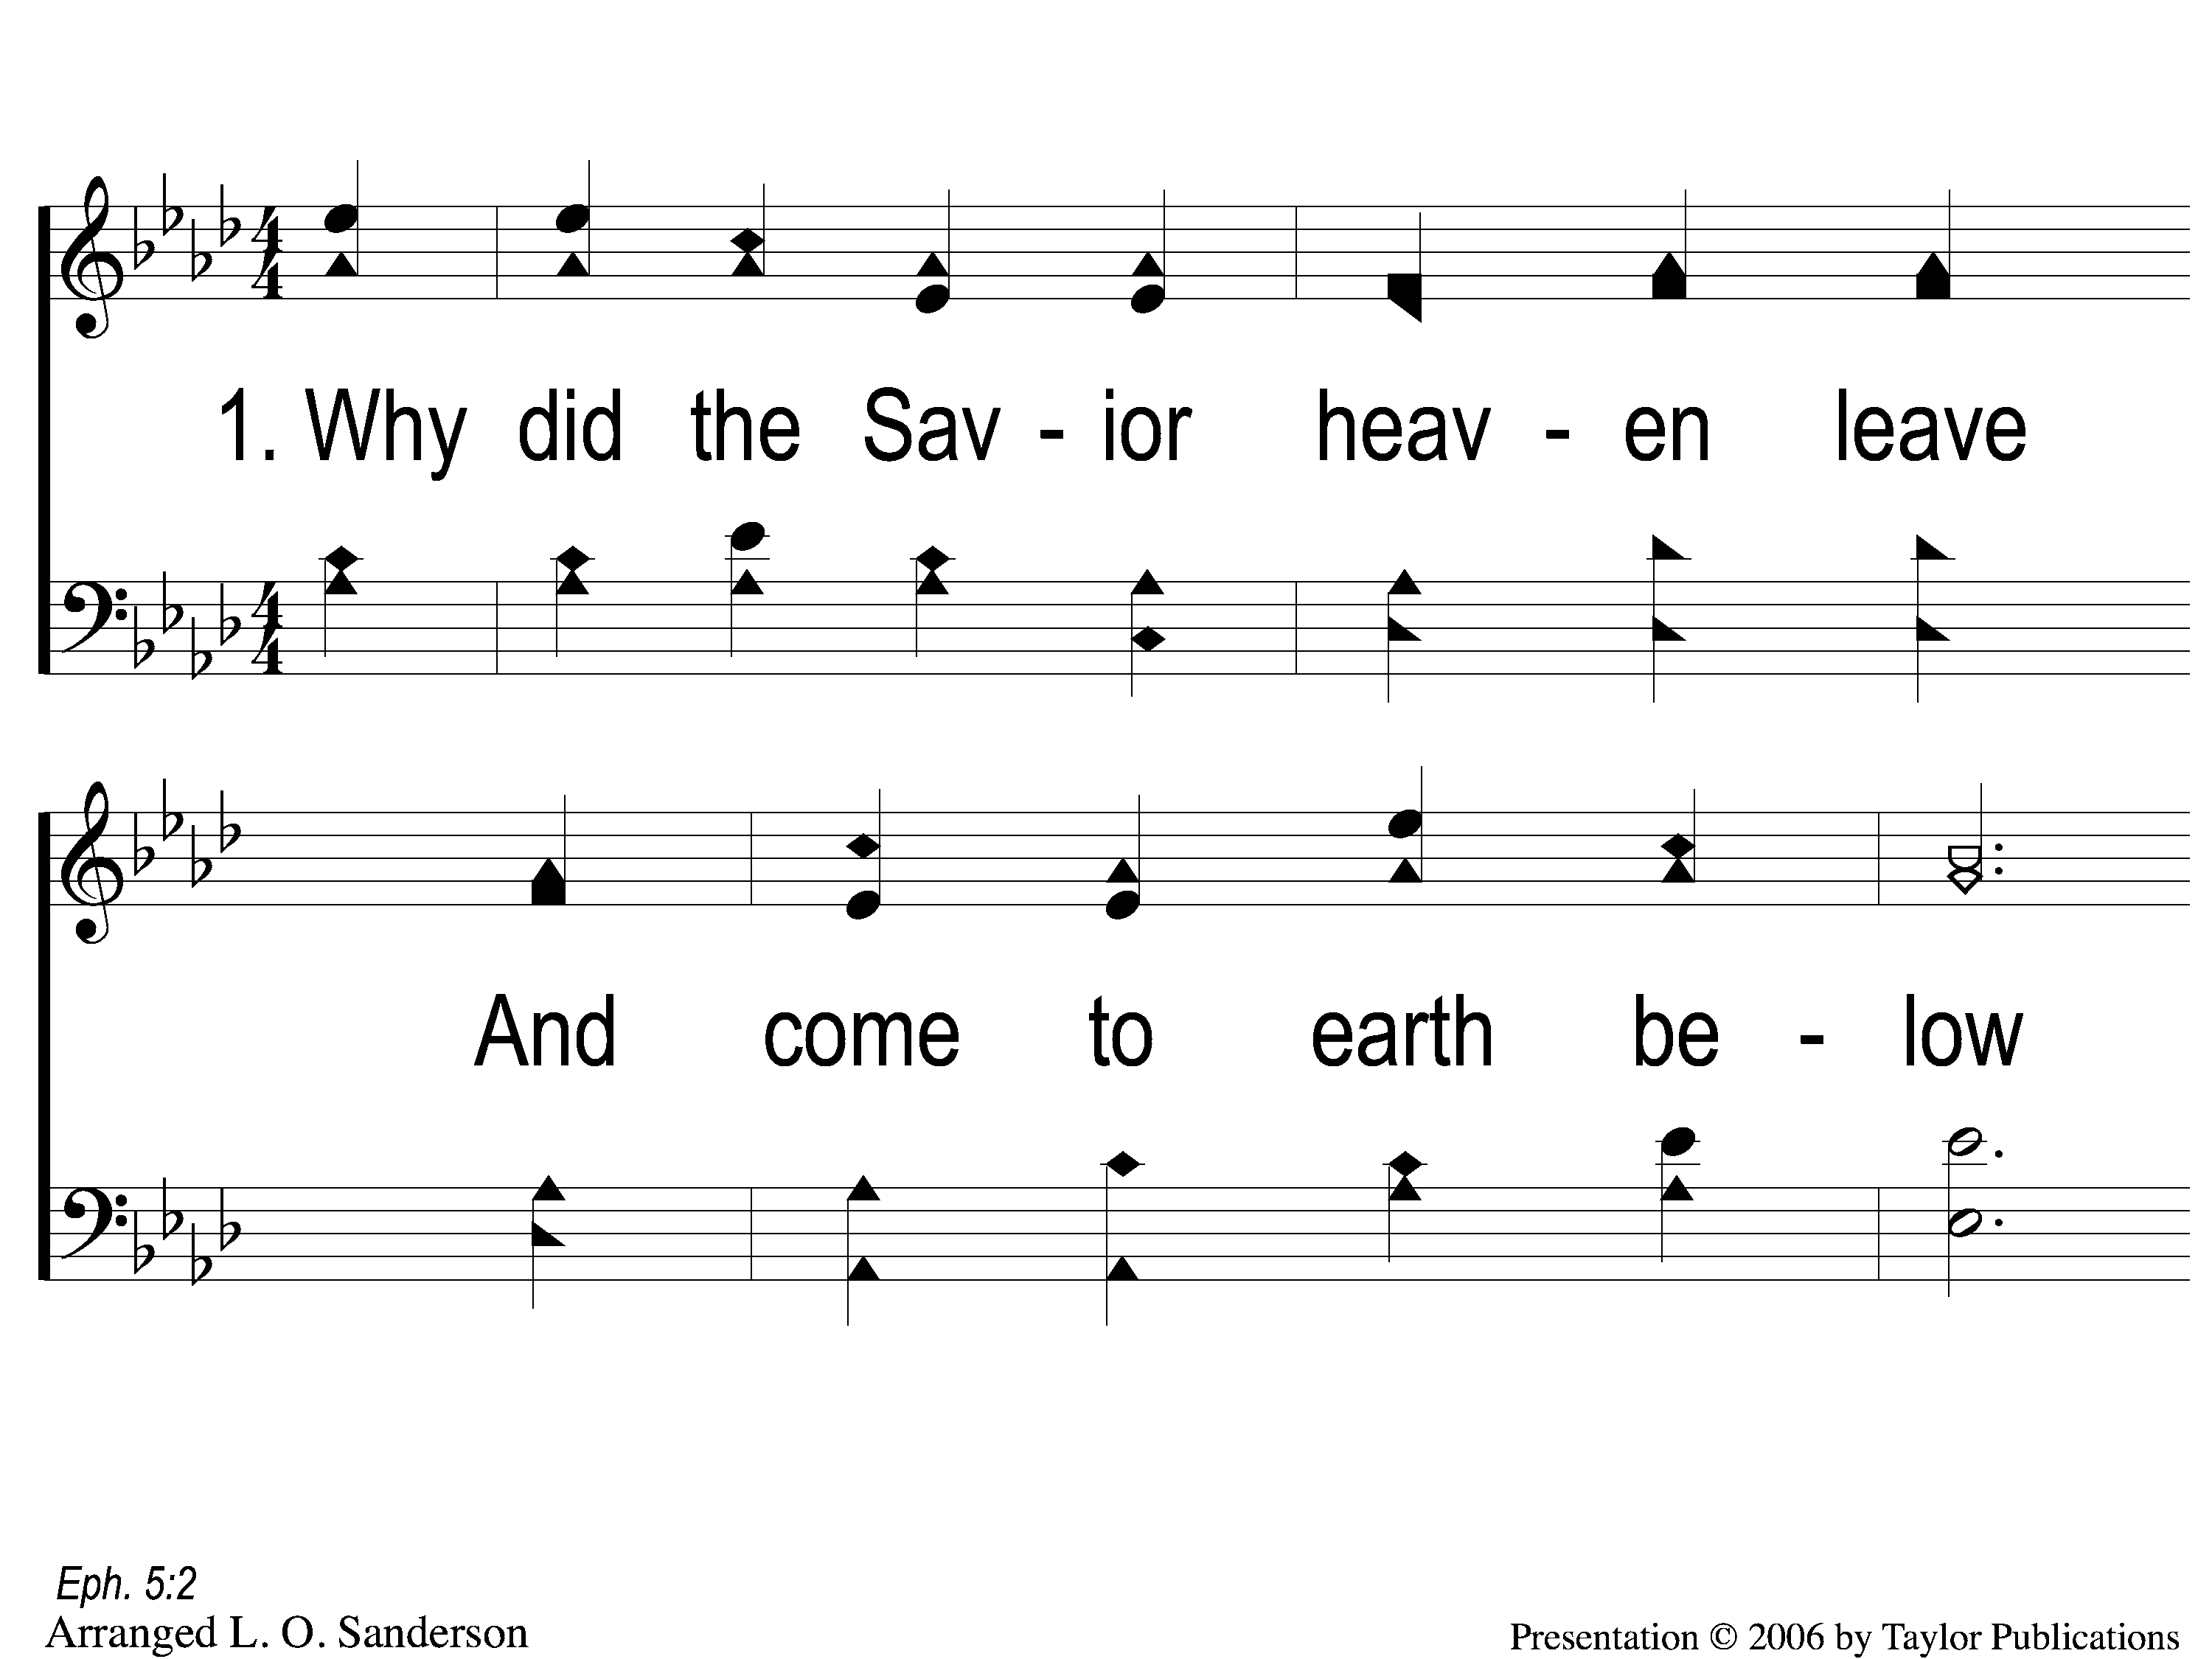
1-1 He Loves Me
He Loves Me
167

Slide 2
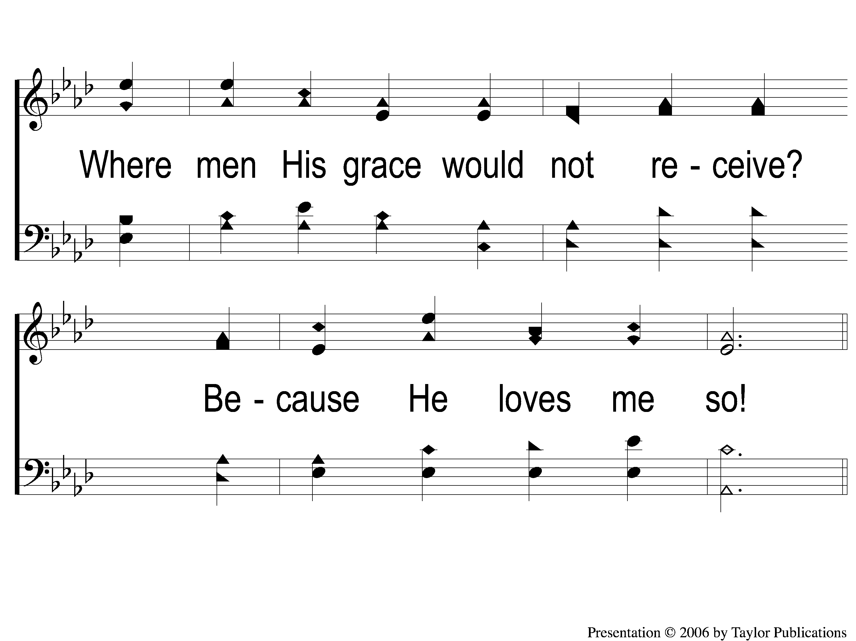
1-2 He Loves Me
He Loves Me
167

Slide 3
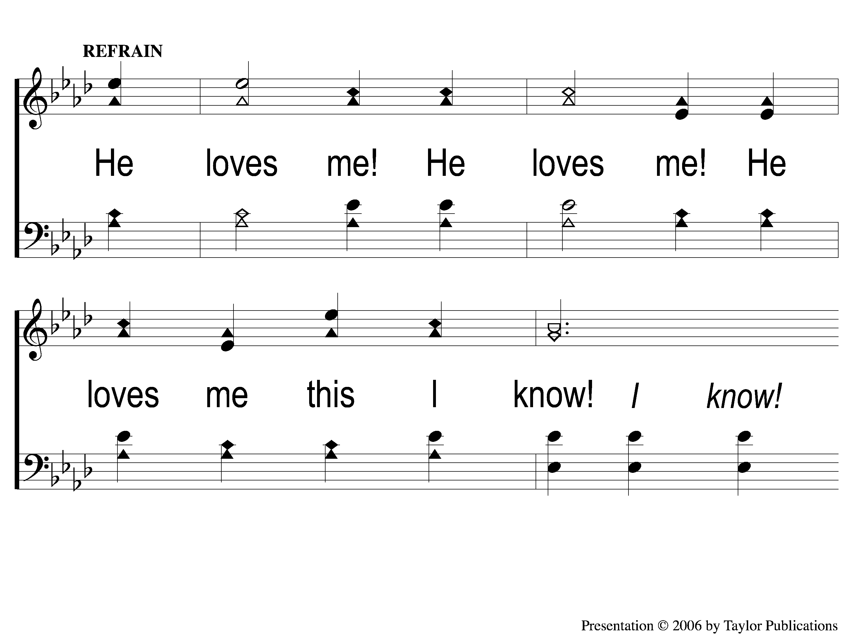
C-1 He Loves Me
He Loves Me
167

Slide 4
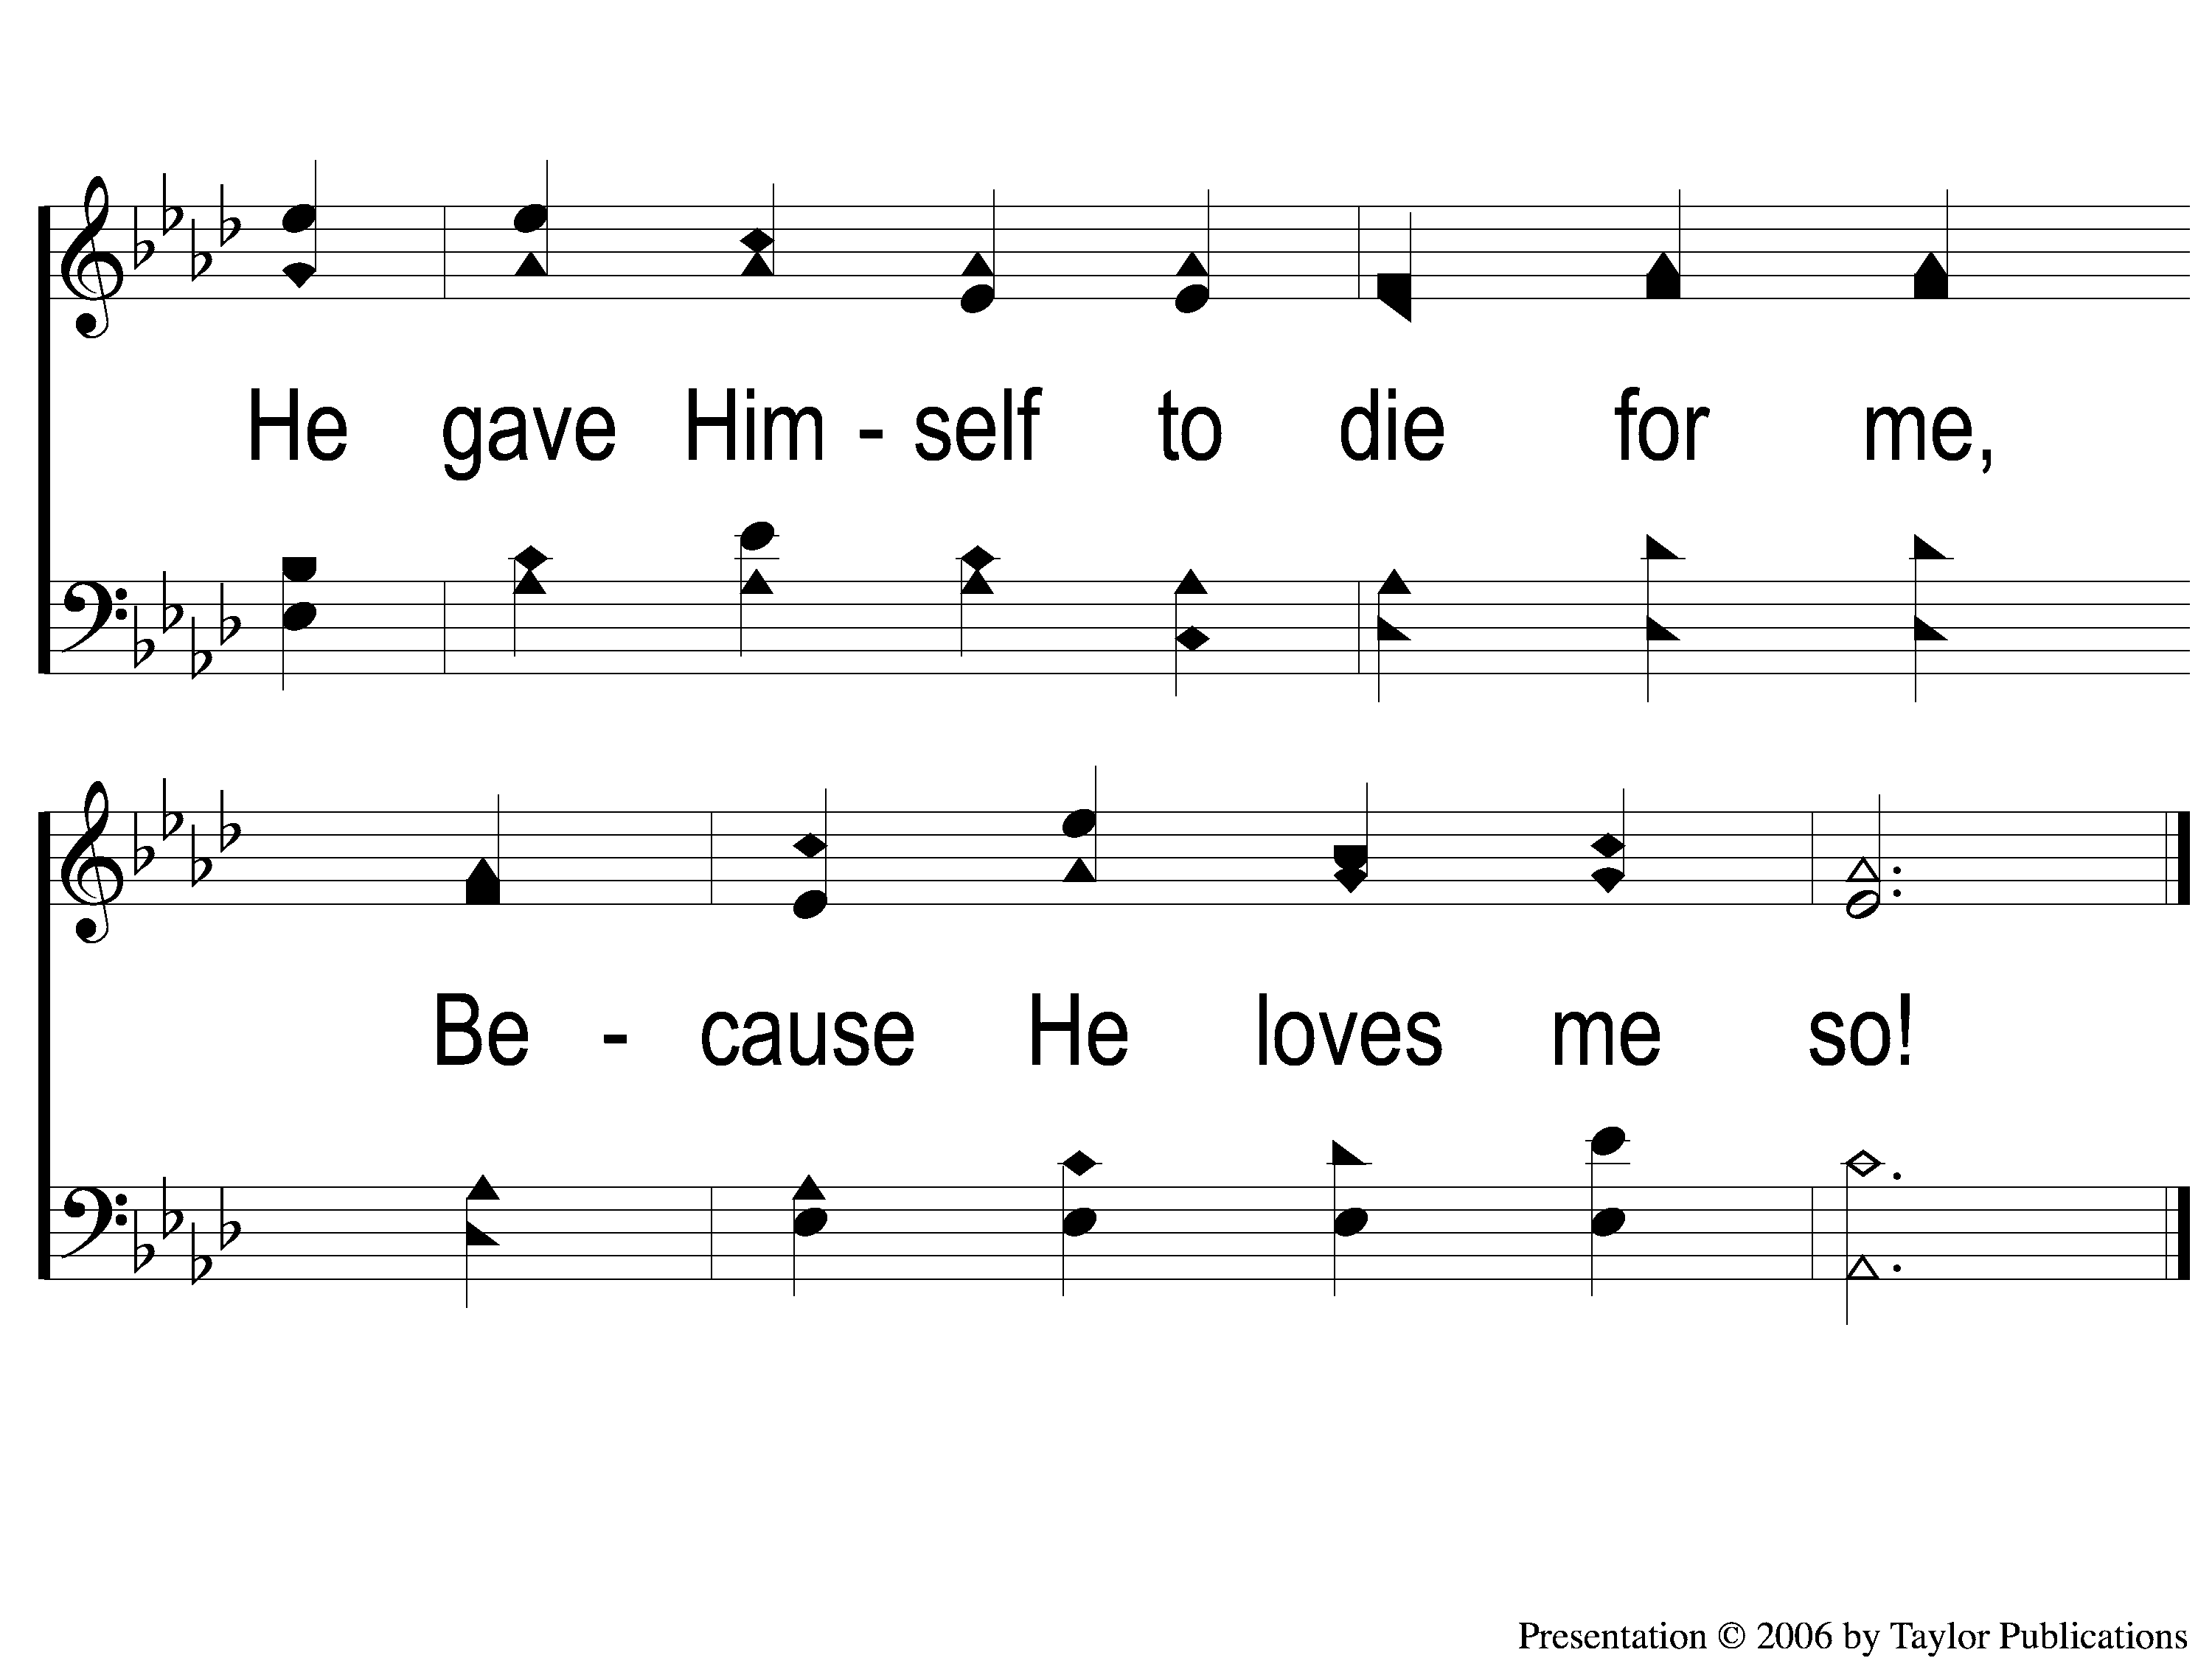
C-2 He Loves Me
He Loves Me
167

Slide 5
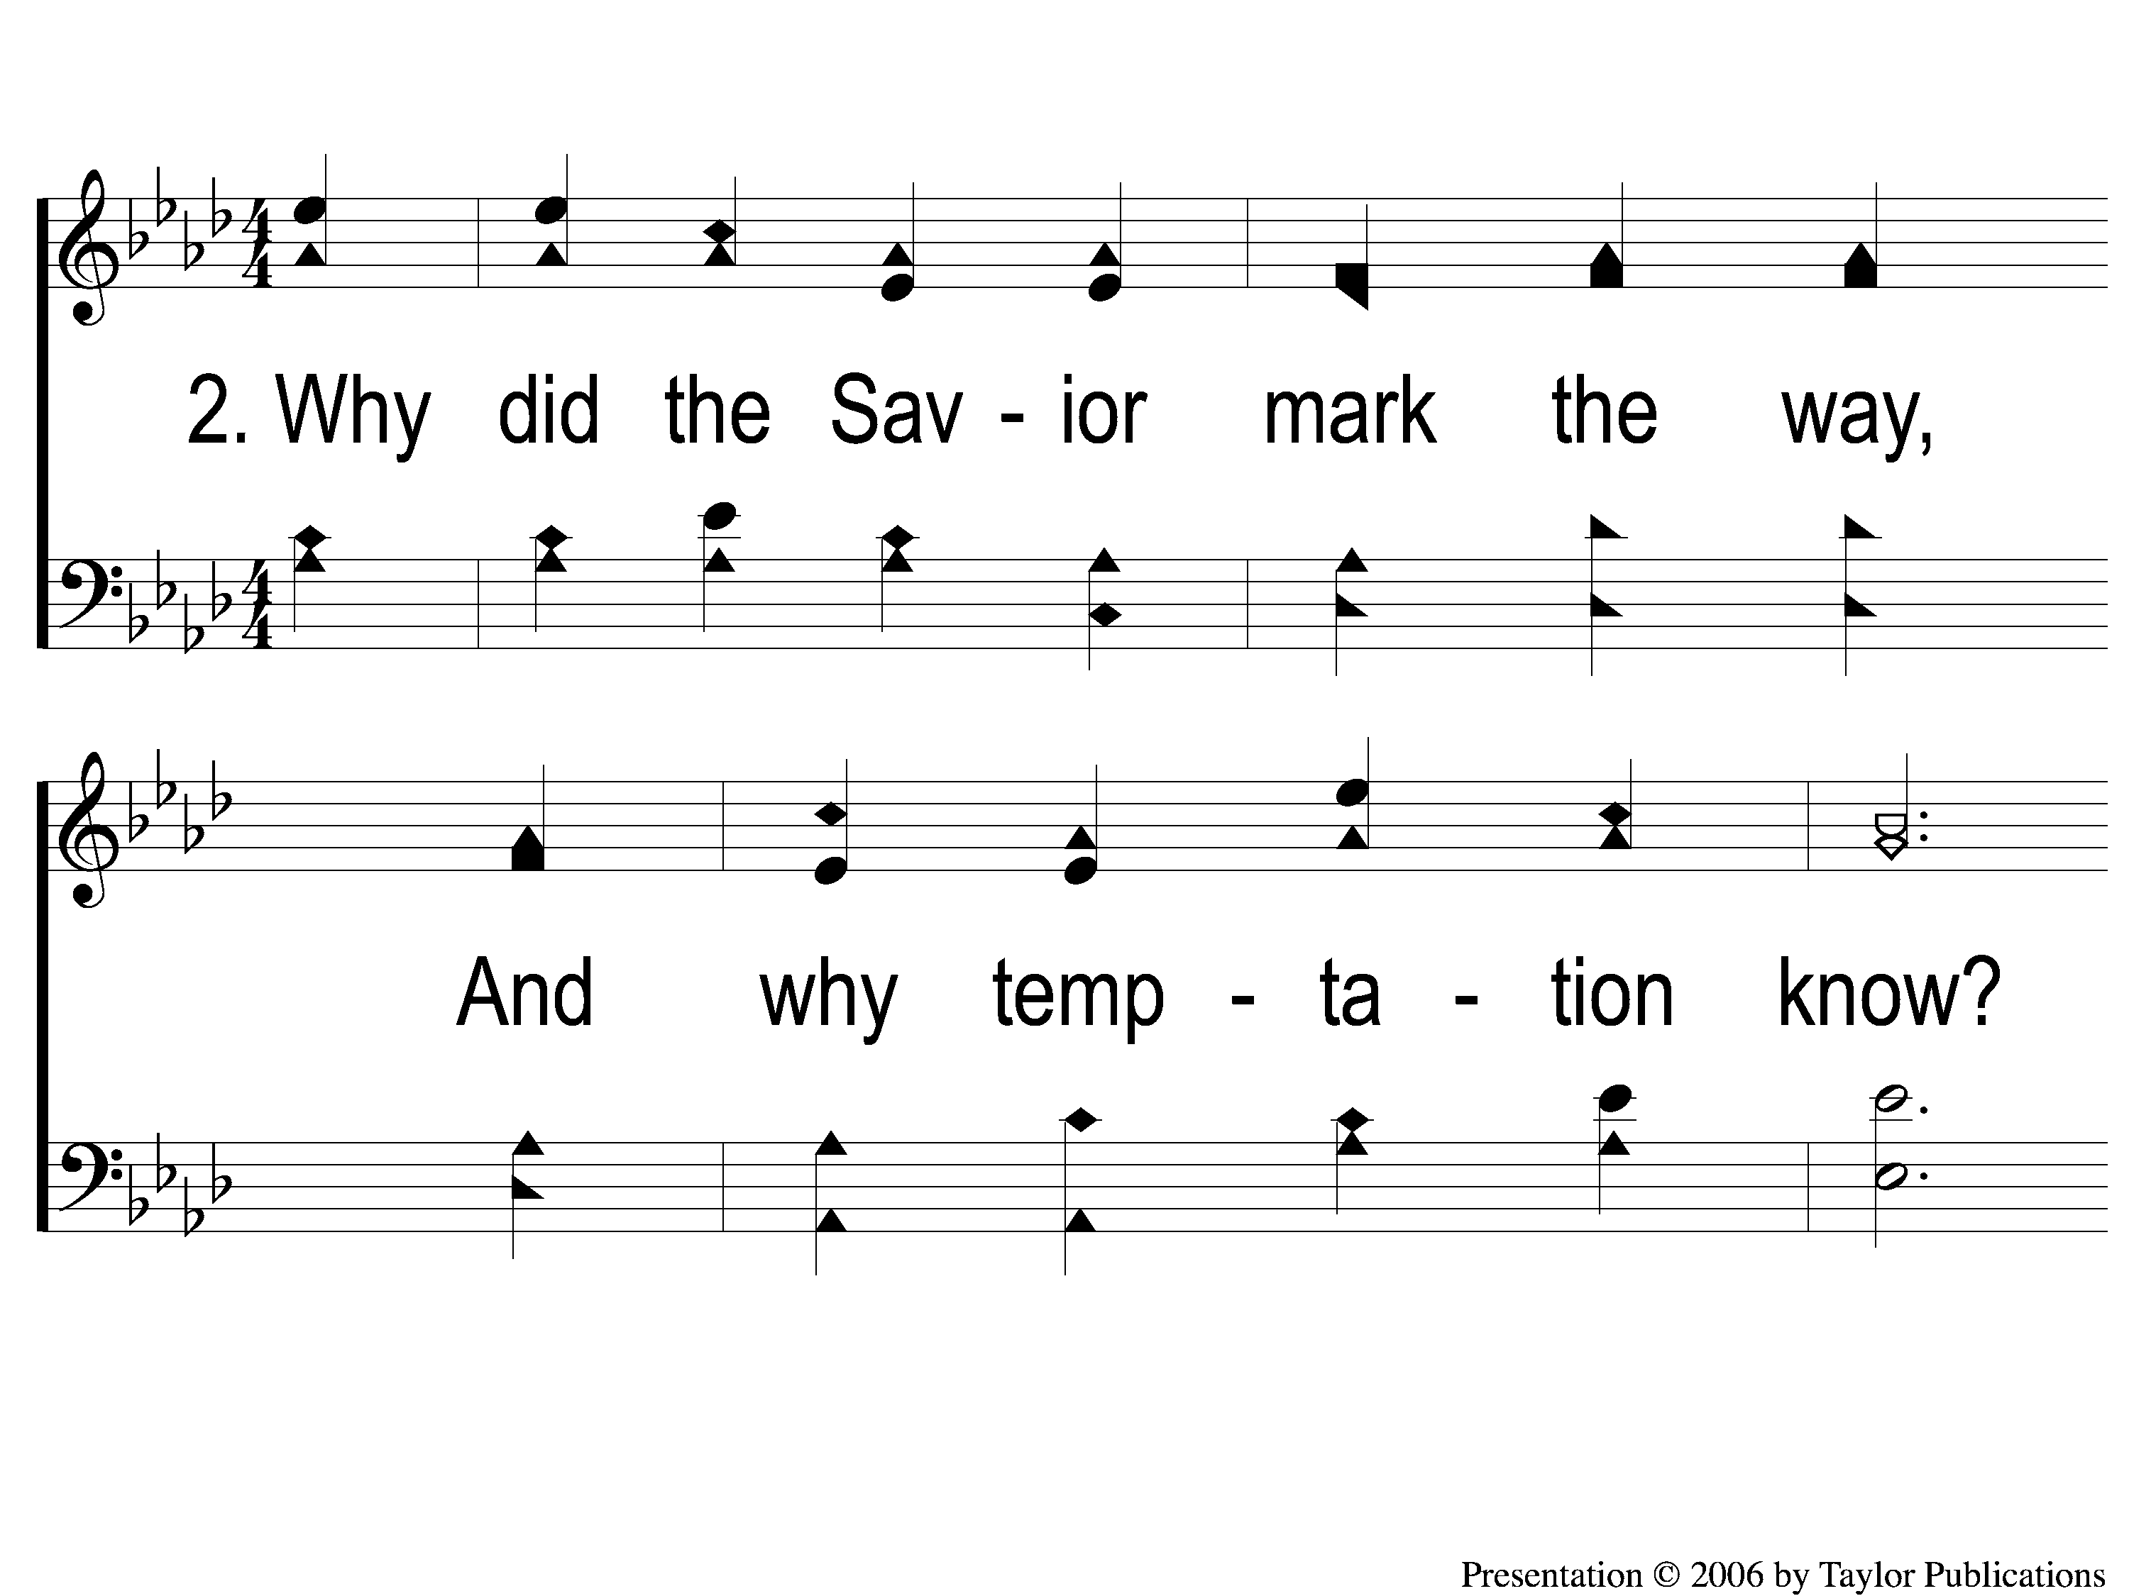
2-1 He Loves Me
He Loves Me
167

Slide 6
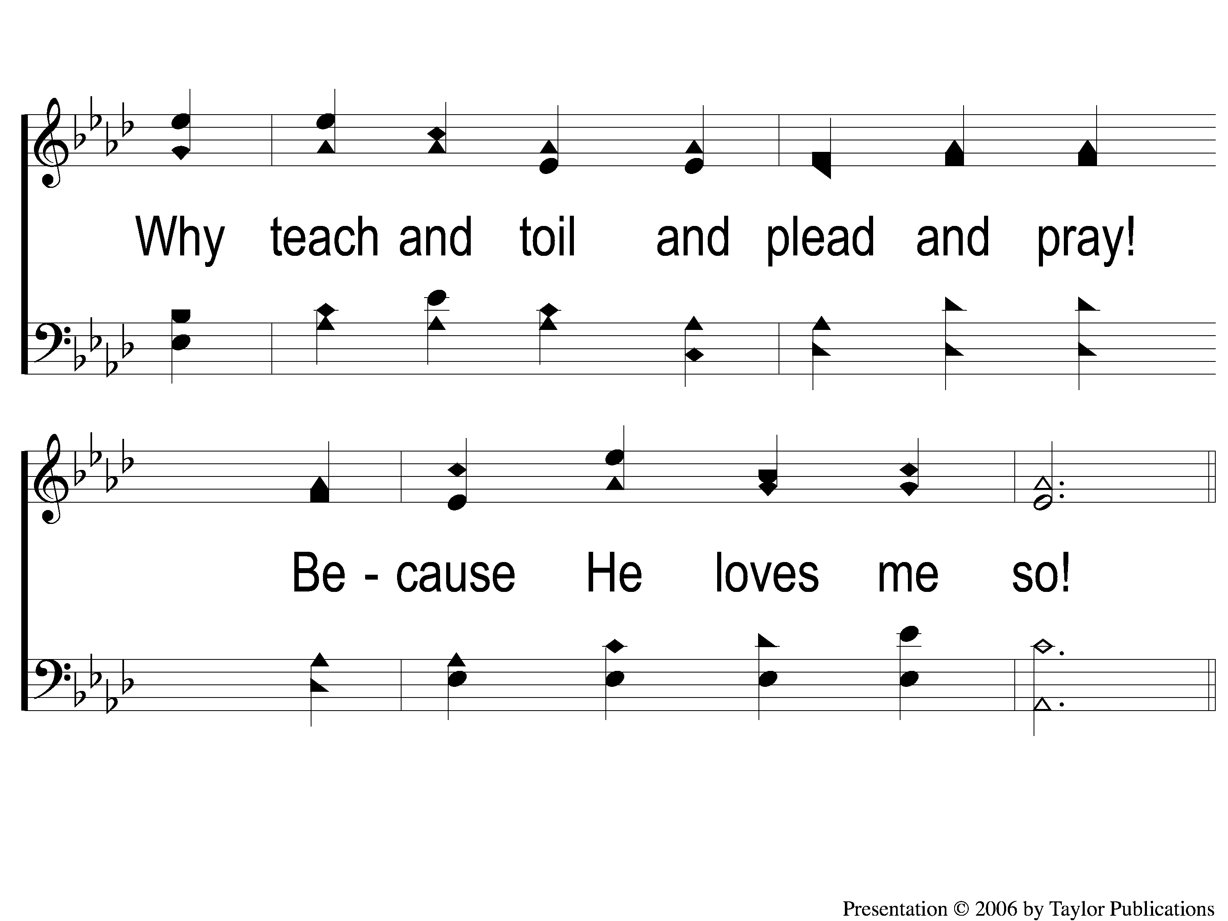
2-2 He Loves Me
He Loves Me
167

Slide 7
C-1 He Loves Me
He Loves Me
167

Slide 8
C-2 He Loves Me
He Loves Me
167

Slide 9
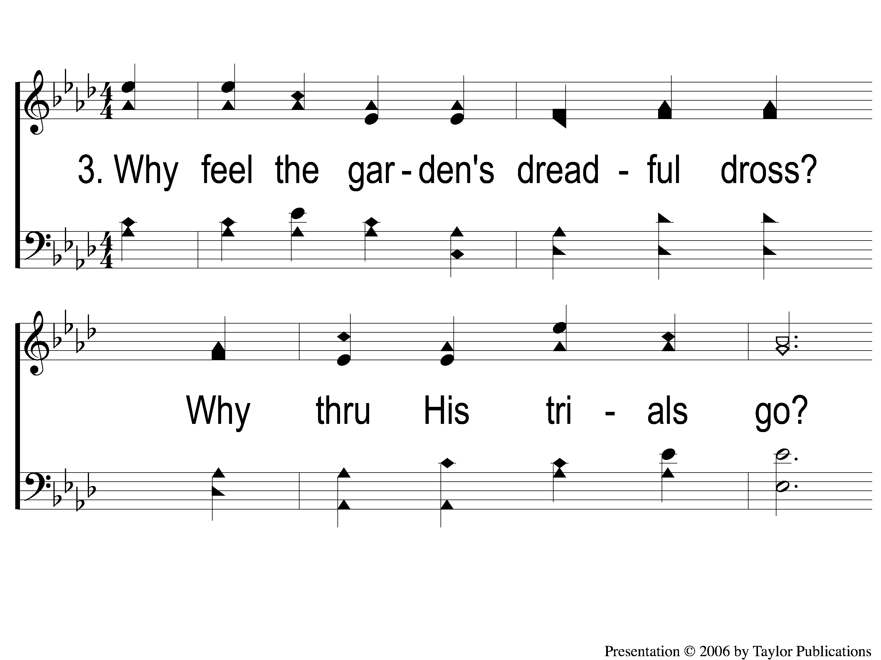
3-1 He Loves Me
He Loves Me
167

Slide 10
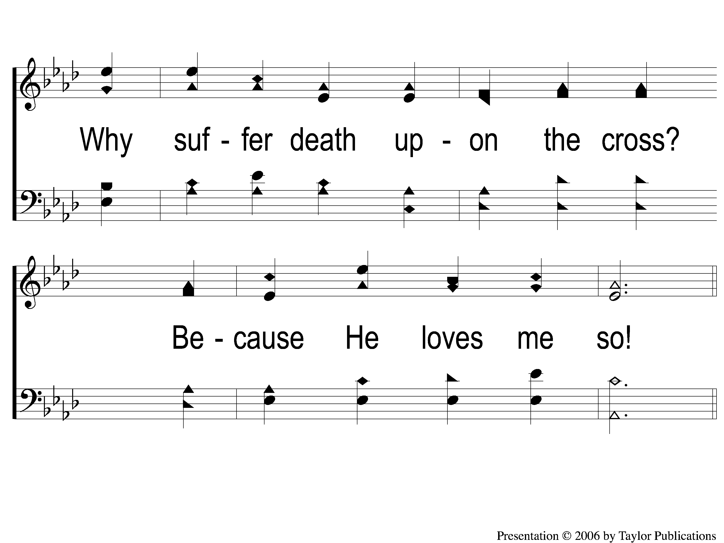
3-2 He Loves Me
He Loves Me
167

Slide 11
C-1 He Loves Me
He Loves Me
167

Slide 12
C-2 He Loves Me
He Loves Me
167

